Slide 1
Configuring and Using Loan Recall Requests
Yoel Kortick – Senior Librarian

Slide 2

Contents
  Introduction
  Configuring Loan Recall Requests with "Is Recallable" set to "true"
  Real use case with "Is Recallable" set to "true"
  Configuring Loan Recall Requests with "Is Recallable" set to "false"
  Real use case with "Is Recallable" set to “false"
  A note regarding fines on recalled items returned late

Slide 3

Introduction

Slide 4
Introduction
When an item is on loan and a request is made on the item, it is possible that a "recall request" be created on the item.
The "recall request" does as follows:
  Changes the status of the loaned to "Recalled"
  Sends a letter to the patron stating that the loan has been recalled
  Depending on configuration it may also shorten the loan period of the item (make the due date earlier than it originally was). If the loan period is shortened, then the new due date will appear in the letter to the patron.

Slide 5
Introduction
The institution can configure Alma to send a recall request for specific situations, such as (but not only)
  If a "booking request" is made on an item which is on loan.
  If a "digitization request" is made on an item which is on loan.
  If a "patron physical item request" is made on an item which is on loan.
  If a "move permanently" or "move temporarily" request is made on an item which is on loan.
For list of all situations whereby a recall request can be triggered see the table at Configuring Loan Recall Requests with "Is Recallable" set to "true".

Slide 6
Introduction
In this presentation we will show how the recall is set up and works for the situation in which a "patron physical item request" is made on an item which is on loan.

Slide 7

Configuring Loan Recall Requests with "Is Recallable" set to "true"

Slide 8
Configuring Loan Recall Requests with "Is Recallable" set to "true"
The configuration for loan recall requests involves multiple components, primarily:
  The "Loan Recalls Configuration" mapping table, which states in which situations a recall is triggered
  The policy "Is Recallable", which states if the item is recallable. The policy is part of the relevant Terms of Use.
  The policy "Recall Period", which determines the amount of time that a patron has to return a recalled item. The policy is part of the relevant Terms of Use.

Slide 9
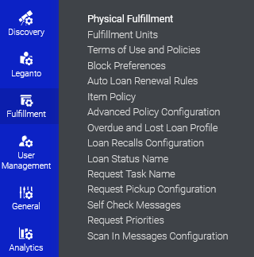
Configuring Loan Recall Requests with "Is Recallable" set to "true"
The "Loan Recalls Configuration" mapping table is accessible at "Configuration > Fulfillment > Physical Fulfillment > Loan Recalls Configuration".

Slide 10
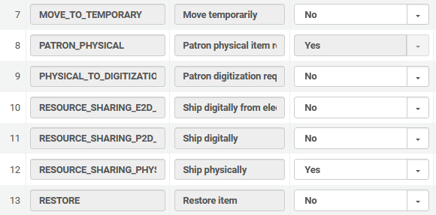
Configuring Loan Recall Requests with "Is Recallable" set to "true"
Here we have defined that recalls will be created when a physical item request is made on an item which is on loan
For an explanation of what each of these lines mean see the table at Configuring Loan Recall Requests with "Is Recallable" set to "true".

Slide 11
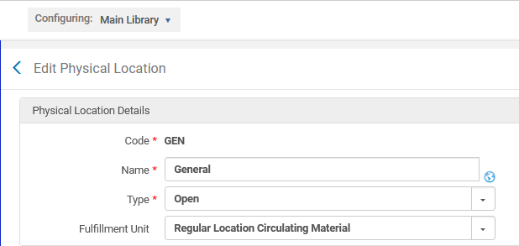
Configuring Loan Recall Requests with "Is Recallable" set to "true"
In addition to setting the relevant lines to "Yes" in the "Loan Recalls Configuration" mapping table, the relevant "Terms Of Use" for the loan must also be set to "Recall Allowed".
In the example here the "Main Library" location "General" uses a fulfillment unit called "Regular Location Circulating Material".

Slide 12
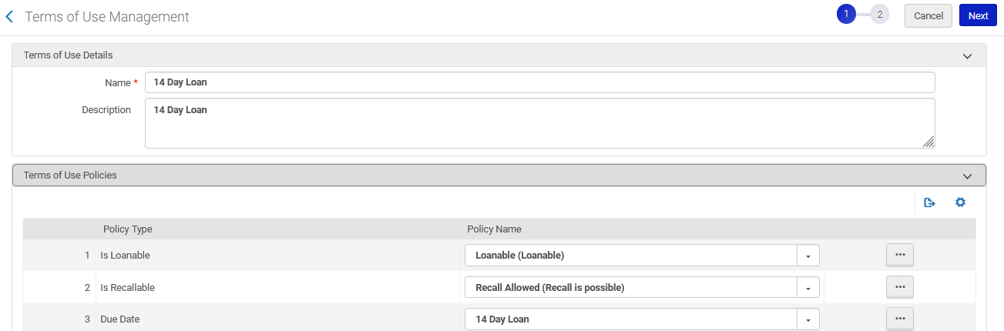
Configuring Loan Recall Requests with "Is Recallable" set to "true"
The fulfillment unit called "Regular Location Circulating Material" has a fulfillment unit rule called "14 Day Loan" which allows recalls.

Slide 13
Configuring Loan Recall Requests with "Is Recallable" set to "true"
Note that in the example we are doing now "Is Recallable" is set to "true".
Later in this presentation we will see an example where "Is Recallable" is set to "false".
If the policy "Is Recallable" is set to
  "true", then the loan status changes to "Recalled" and the due date on the loan changes.
  "false", then the loan status changes to "Recalled" and the due date on the loan does not change.

Slide 14
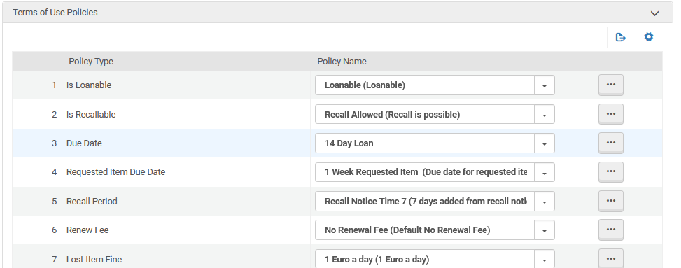
Configuring Loan Recall Requests with "Is Recallable" set to "true"
The "Recall Period" is defined as 7 days

Slide 15

Real use case with "Is Recallable" set to "true"

Slide 16
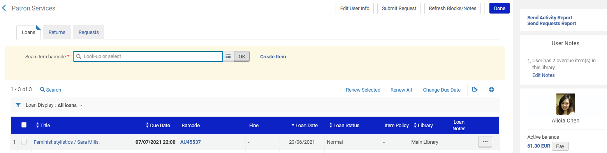
Real use case with "Is Recallable" set to "true"
The item gets loaned to patron Alicia Chen for 14 days.

Slide 17
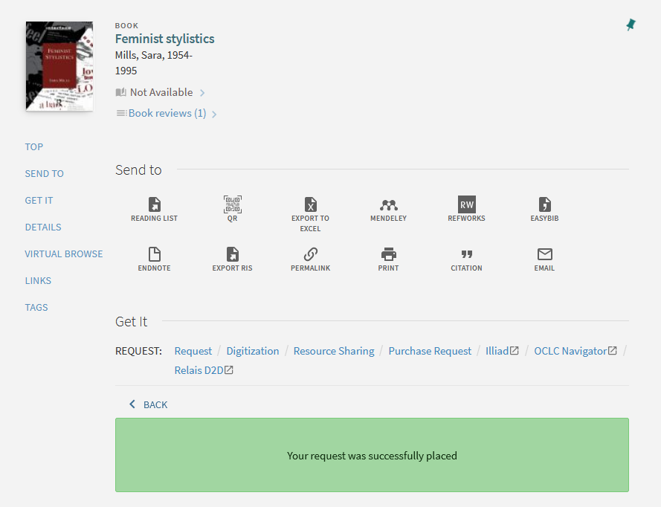
Real use case with "Is Recallable" set to "true"
Patron Bjørg Nordli-Mathisen logs into Primo, sees it is not available, and makes a physical item request for it.

Slide 18
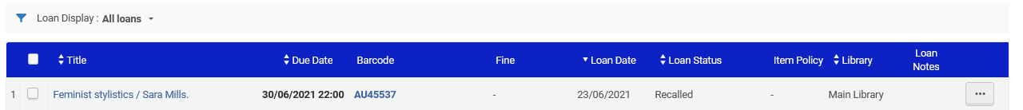
Real use case with "Is Recallable" set to "true"
The loan gets a status of "Recalled"

Slide 19
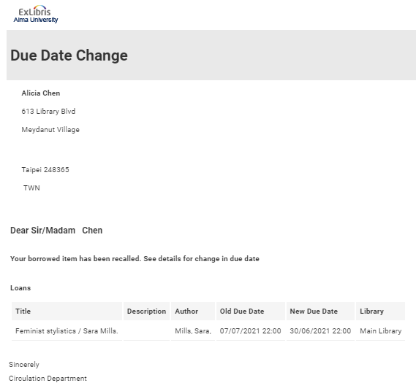
Real use case with "Is Recallable" set to "true"
Patron Alicia Chen gets a letter that the due date has changed

Slide 20
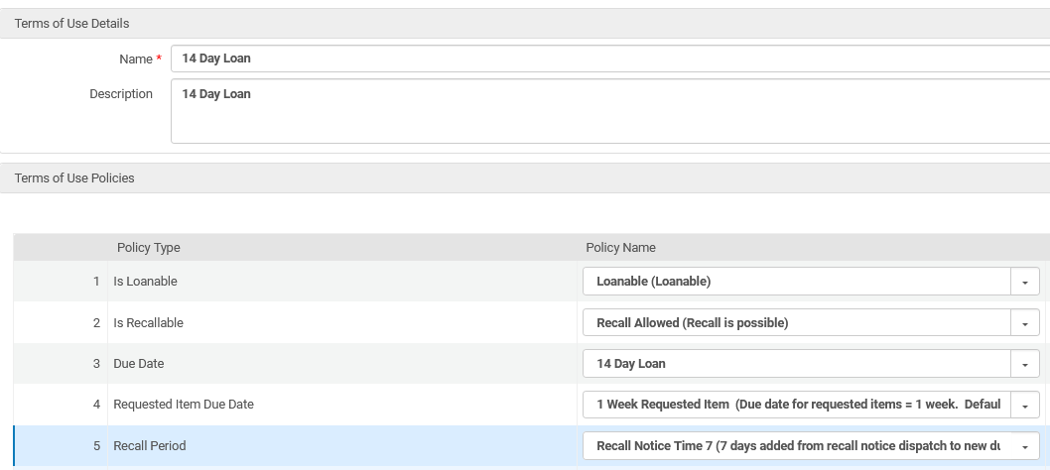
Real use case with "Is Recallable" set to "true"
The reason the loan got shortened to June 30th when the notice was sent out on June 23 is because the "Terms Of Use" has a "Recall Period" defined as "Recall Notice Time 7".

Slide 21
Real use case with "Is Recallable" set to "true"
The options for the "Recall Period" are defined in the ‘Advanced Policy Configuration" at "Configuration > Fulfillment > Physical Fulfillment"

Slide 22
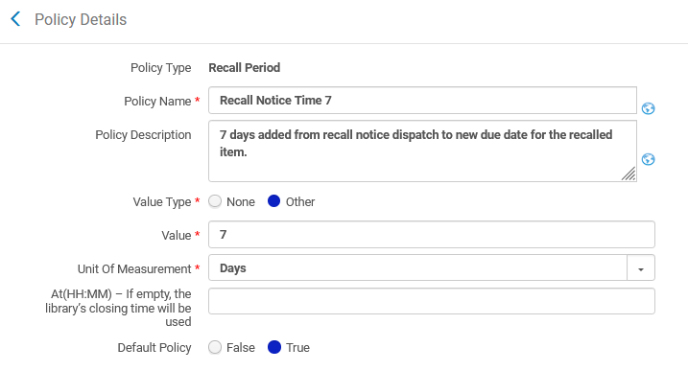
Real use case with "Is Recallable" set to "true"
Here is the policy which is used in the term of use and is called "Recall Notice Time 7". It is defined as 7 days.

Slide 23
Real use case with "Is Recallable" set to "true"
Note:
If title "Feminist stylistics" had more than one item, and another item was available, then a recall would not have been issued to Alicia Chen.
If title "Feminist stylistics" had more than one item, and all items were on loan, then the recall is placed on the oldest loan (not considering the due date and due date policy of each loan)

Slide 24


Configuring Loan Recall Requests with "Is Recallable" set to "false"

Slide 25
Configuring Loan Recall Requests with "Is Recallable" set to "false"
If the following two conditions exist:
  "Terms Of Use" policy "Is Recallable" is defined as "No Recall" (it is "Not Recallable")
  Mapping table "Loan Recalls Configuration" parameter PATRON_PHYSICAL is defined as "Yes"
Then when a physical item request is made on a loaned item:
  The loan changes to status "Recalled"
  The patron with the item on loan receives a letter that the loan has been recalled
  The return date of the loan does not change
  The loan cannot be renewed
Thus we can conclude that
  "Not recallable" does not mean there will be no recall. It just means there will be no change of due date.

Slide 26
Configuring Loan Recall Requests with "Is Recallable" set to "false"
In the example here we have the following definitions:
In the "Terms Of Use" "14 Day Loan" the policy "Is Recallable" is defined as "No Recall"
In the mapping table "Loan Recalls Configuration" PATRON_PHYSICAL is defined as "Yes"

Slide 27

Real use case with "Is Recallable" set to "false"

Slide 28
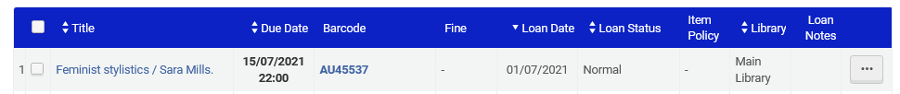
Real use case with "Is Recallable" set to "false"
Item barcode is loaned to patron Alicia Chen for 14 days and has Loan Status "normal"
Loan date is July 1, due date is July 15

Slide 29
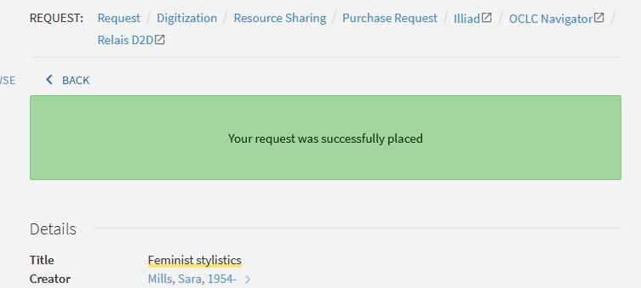
Real use case with "Is Recallable" set to "false"
Patron Bjørg Nordli-Mathisen logs into Primo, sees it is not available, and makes a physical item request for it.

Slide 30
Real use case with "Is Recallable" set to "false"
The due date for the loan remains June 15 (it does not change).
The status of the loan changes to "Recalled"

Slide 31
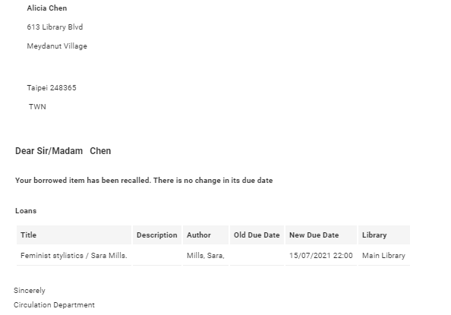
Real use case with "Is Recallable" set to "false"
A "Recall" letter is sent to patron Alicia Chen, but there is no change in due date.
It remains July 15.

Slide 32
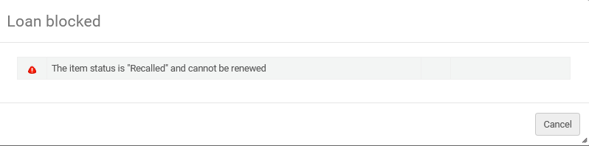
Real use case with "Is Recallable" set to "false"
The item cannot be renewed because the loan status is "Recalled"

Slide 33


A note regarding fines on recalled items returned late

Slide 34
A note regarding fines on recalled items returned late
It is possible to have a different fine for an item which was recalled and returned late than for an item which was returned late but not recalled.
This is done by using the Recalled Overdue Fine
  The "Overdue Fine" is for items returned late but not recalled
  The "Recall Overdue Fine" is for items which we recalled and returned late

Slide 35
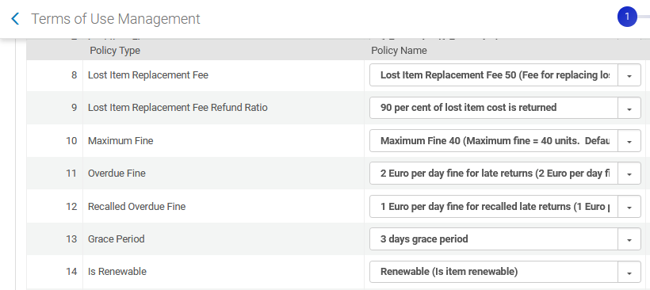
A note regarding fines on recalled items returned late

Slide 36
xxx@exlibrisgroup.com

